Slide 1

=
Pharmaceutical Sales Performance Dashboard

Slide 2
Antibiotics: These medicines help fight bacterial infections by killing bacteria or stopping their growth. They are commonly used for infections like sore throat, pneumonia, and skin infections.
Antidiabetics: These medicines help control blood sugar levels in people with diabetes. They work by improving insulin action or reducing glucose production in the body.
Analgesics: These are pain-relieving medicines used to treat mild to severe pain. They work by blocking pain signals to the brain or reducing inflammation.
Antihistamines: These medicines help relieve allergy symptoms like sneezing, itching, and runny nose. They work by blocking the effects of histamine released during allergic reactions.

Slide 3
Regional Performance Analysis
Key Insights
North Zone leads with 35% market share, driven by prescription antibiotics
East Zone shows strong antidiabetic sales with Rajesh Kumar's territory
South Zone excels in OTC analgesics through Priya Nair's efforts
West Zone presents growth opportunity in antihistamine segment

Slide 4
Product Category
Antibiotics
Antidiabetics
Analgesics
Antihistamines
Top Products: Azithromycin, Ciprofloxacin, Amoxicillin
Top Products: Metformin, Glimepiride, Losartan
Top Products: Paracetamol, Ibuprofen
Top Products: Cetirizine, Loratadine
Avg Price: $1.55
Avg Price: $1.25
Avg Price: $2.85
High-volume OTC category with excellent South Zone market penetration.
OTC segment with growth potential, particularly in West Zone markets.
Avg Price: $2.65
Growing segment with strong East Zone performance and premium pricing.
Prescription-only segment with highest revenue contribution and consistent demand.

Slide 5

Sales Representative Performance
520K
380K
John Smith
Priya Nair
North Zone - Antibiotics specialist with 98% target achievement rate
South Zone - OTC leader with exceptional analgesic sales volume
450K
250K
Rajesh Kumar
Neha Singh
East Zone - Antidiabetic expert with consistent prescription growth
West Zone - Antihistamine focus with emerging market potential

Slide 6
Top Performing Products
Azithromycin 250mg
Metformin 500mg
Paracetamol 650mg
Category: Antibiotic
Category: Antidiabetic
Category: Analgesic
Avg Units: 980/month
Avg Units: 1,510/month
Avg Units: 1,120/month
Price: $1.50
Price: $2.80
Price: $3.00
Consistent performer across all regions with strong prescription demand.
High-value product with steady growth in East Zone markets.
Volume leader in OTC segment
with exceptional South Zone
performance.

Slide 7
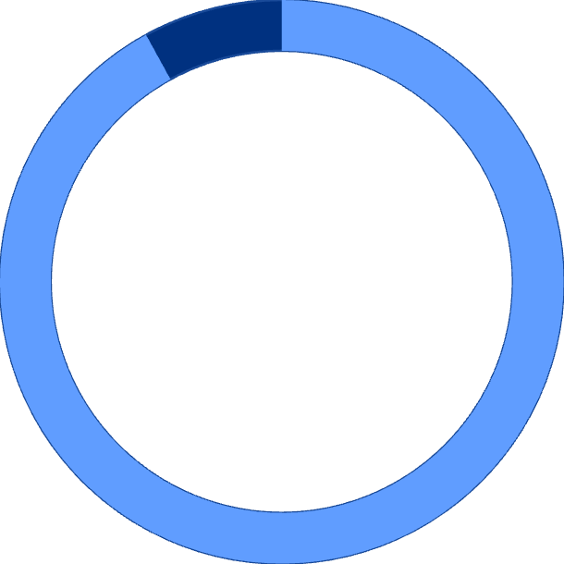
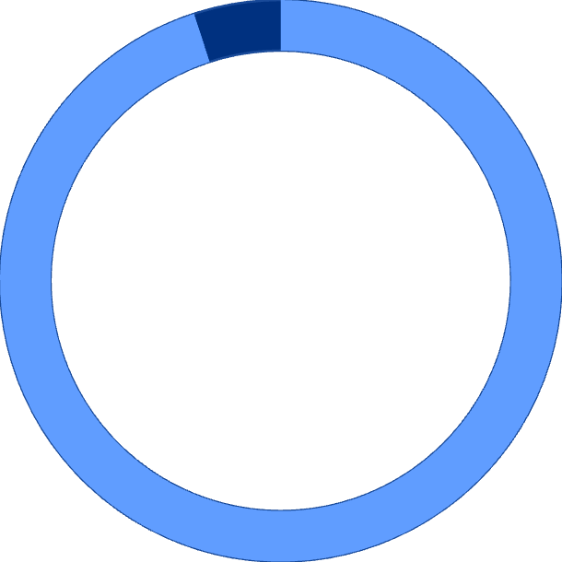
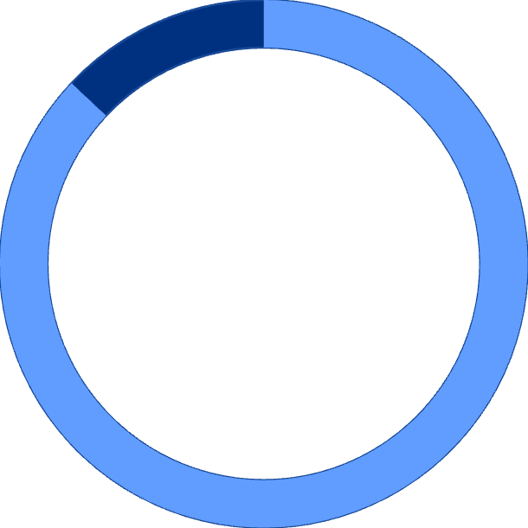

Target Achievement Analysis
92%
95%
Overall Achievement
Prescription Drugs
Company-wide target performance across all products and regions
Strong performance in high-value prescription medication segment
87%
98%
OTC Products
North Zone
Solid achievement with room for growth in over-the-counter sales
Top-performing region exceeding targets consistently

Slide 8

Strategic Recommendations
Expand North Zone
Leverage John Smith's success with antibiotics. Increase inventory of high-performing prescription products and explore adjacent territories.
Boost West Zone
Support Neha Singh with targeted antihistamine promotions. Focus on OTC market development and seasonal allergy campaigns.
Optimize Pricing
Review unit prices for underperforming products. Consider volume discounts for high-demand OTC items to increase market share.

Slide 9
Key Takeaways
Strong Overall Performance
Regional Opportunities
92% target achievement with $1.5M total sales demonstrates solid market position and effective sales strategies across all regions.
North and East Zones excel, while West Zone presents significant growth potential. Targeted support can unlock additional revenue streams.
Product Mix Optimization
Team Excellence
Prescription drugs drive revenue, but OTC products offer volume advantages. Balanced portfolio approach maximizes market coverage.
Sales representatives demonstrate strong product knowledge and territory management. Continued training and support will sustain growth momentum.

Slide 10
THANK YOU

